Slide 1
Bookbot Pitch
Project By the “Dream Team”
(Amrita, Anastasia, Ankita, Sarah & Michelle

Slide 2
What is Bookbot? What is their vision
Bookbot is an app for children, learning to read and those struggling to read.
With the Bookbot app, a child reads out loud, Bookbot listens. Whenever the child struggles Bookbot steps in.
Vision to reach out to as many kids as possible with main focus on kids with disability of reading.
Having a child learn to reading and enjoying reading while parents are busy is main aim of the app.

Slide 3
Who is Bookbot’s customer and who is their audience?
1. Kids with reading disabilities and difficulties (those with Dyslexia)
2. Parents who are busy and can’t pay attention to kids while reading
3. Primary School teachers and childrens helping kids to read
Teacher
facebook ads channel : able to target parents, moms, worrying about academic development- primary school children mom,
Parents who can’t supervise their children full time and teaching
Main goal in future to reach out to English teaching classrooms in various countries mainly asia, Africa, UK etc.

Slide 4
The problem Bookbot are facing right now
1 Getting into School really hard , School have limited budget,
(looking at different models, Every school has different reading systems)
2. To get more audience and popularity
3. Design Style
4. Marketing Campaigns – no Fb ads

Slide 5
SEO Problems
PROBLEM #1: - Only use 1 H1 Heading in your text.
WHAT IS THIS? - Headings help readers and Google understand your text. If there are multiple H1 headings, your readers and Google might get confused. SOLUTION #1: - Find all H1s in your text and change them to a lower heading level.
PROBLEM #2: -Try to reduce the number of used JavaScript files.
WHAT IS IT? - Every time your website loads a Javascript file it creates a new HTTP Request to load and analyze the file before it can render your HTML page.
SOLUTION #2: - When your web page only loads a few small Javascripts you should try to inline them. In lining scripts is best for page speed. - Optimize your Javascripts in the best way possible you can compress them with the Javascript Compressor.
PROBLEM #3: -No sitemap.xml to optimize interaction with bots. What is sitemap.xml? - Sitemap.xml files can facilitate your chances of ranking by making your site easier to crawl by search engines. - XML sitemap makes it easy for the crawler to see what’s on your website and index it. - The XML sitemap tells Google what to crawl on your website. - The XML sitemap shows Google all the pages on your website, even if they are deep within the architecture and might not otherwise be crawled as quickly. SOLUTION #3: 1. Create your XML sitemap. 2. Add your XML sitemap to your website. 3. Submit your XML sitemap to Google. PROBLEM #4: - 19 pages have a low word count. WHAT IS THIS? - Without enough text on a page, Google will have trouble understanding what the content is about. - If Google doesn't know what the content is about, it won't be able to rank your content for the search terms you are targeting. SOLUTION #4: - Add more content to your page so that it isn

Slide 6
Our solution
Tour of the website, exploring:
Design
Branding
Product features
Technical features of site
SEO
User journey

Slide 7

Dream Team’s Bookbot
Hello, my name is Oliver!
Join me in my learning adventure!

Slide 8
Design and Branding
We created Oliver and he is a real boy who is looking for friends. Bookbot is ready to help and they will enjoy their reading Journey.
Used Various Pictures in app and website to attract all kinds of kids (from different ethinic backgrounds)
Logo Font: Playfair Display
Main Font:Raleway

Slide 9
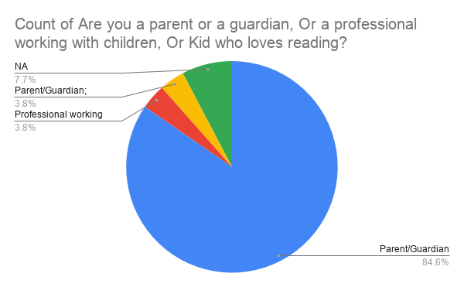
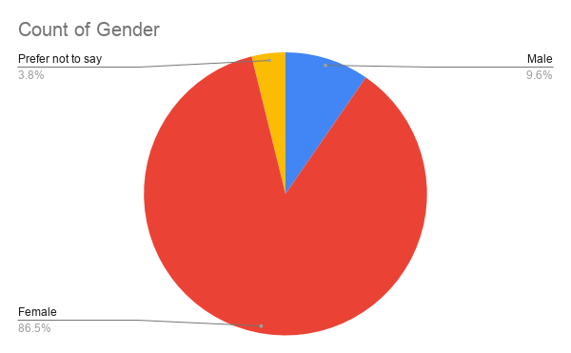
Market Survey Analysis

Slide 10
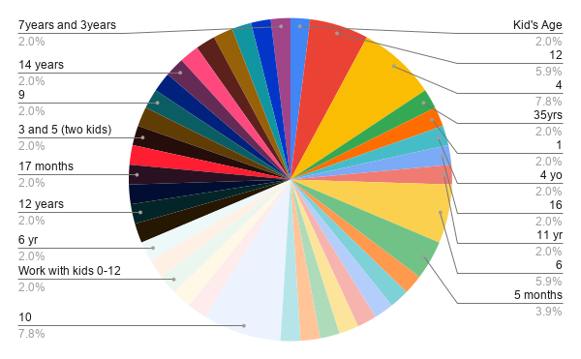
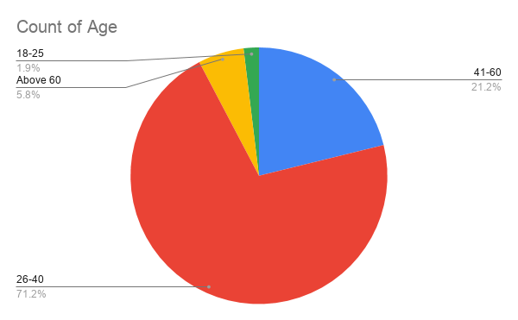

Slide 11
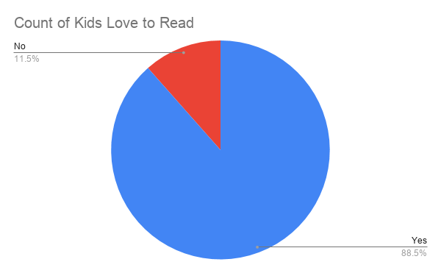
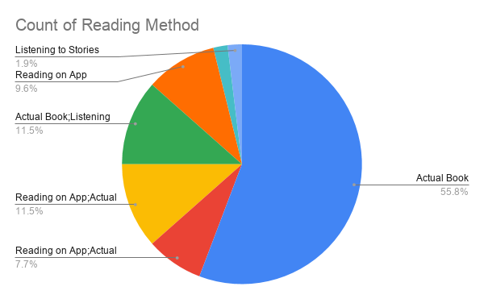

Slide 12
Product Features
1. Chat Bot (24/7) - Home Page for immediate customer service
2. Directory of all books - quick search option for kids to find book of their choice
3. Creative colorful Images to attract kids to browse easily in app
4. Short story videos clip for those who don’t wish to read whole book
6. Interactive learning game feature to encourage to learn and read same time
7. Star rating for app and/or book - user feedback can be given
8. Compatible on desktop, Android and other mobile phones

Slide 13
SEO
1.Improve the page response time.
2. Added a meta description.
3. Try to reduce the number of used CSS files.
4.Try to reduce the number of used JavaScript files
5.The page title to fit better to the content of the page.
6. The H1 heading to fit better to the page content.
7. Use good alternative descriptions (alt attributes) for images.

Slide 14
Technical Features of Site
1. Voice Recognition
2. Customized Avatars for Kids
3. Downloadable book feature
4. Progress Feature

Slide 15
User Journey and Conclusion
We wish to target kids of all types who wish to read more or learn to read
Turn Your kids to a voracious reader
Provide them with collection and features that kids will love and get hooked too
Provide and easy to use for parents and kids

